Slide 1
Introduction to machine learning

Slide 2
Disclaimer
I stole the following couple of slides. You know them. But this course is a step in a long path and the slides give that overview, so you need them to fully grasp where we are and where we are going.

Slide 3

Definition of A.I.
Discovery
Many, many, many different definitions of AI
Pretty good one:
‘Theory and development of technology able to perform tasks normally requiring human intelligence’

Slide 4
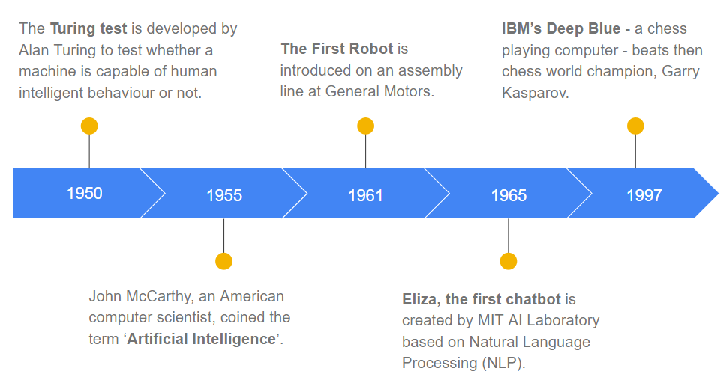
History of AI
Discovery

Slide 5
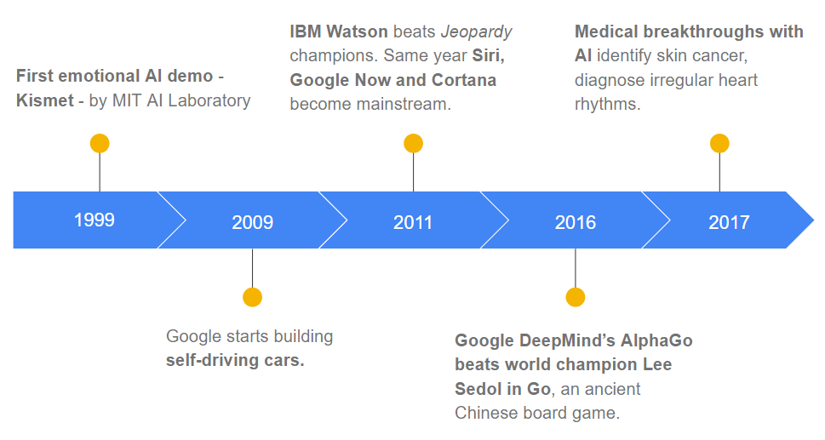
History of AI
Discovery

Slide 6
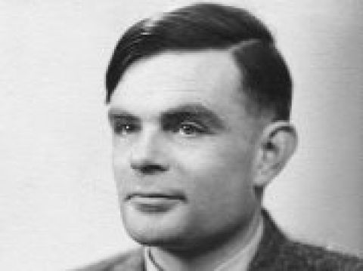
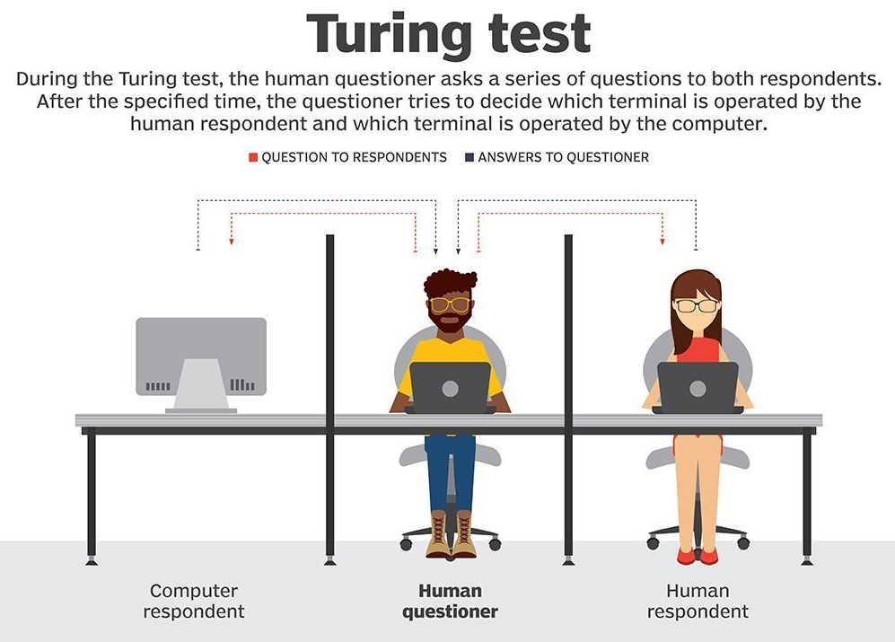
Turing Test
Discovery

Slide 7
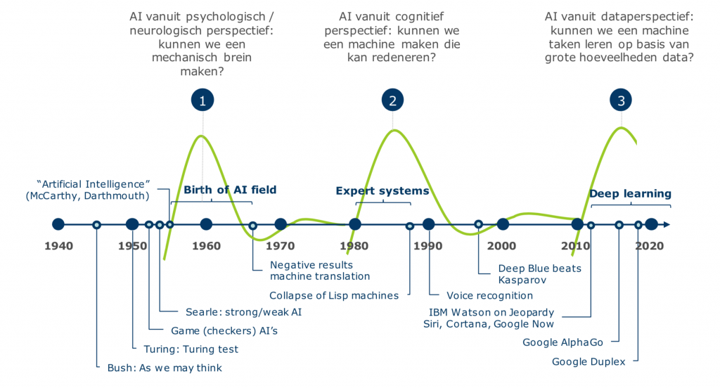
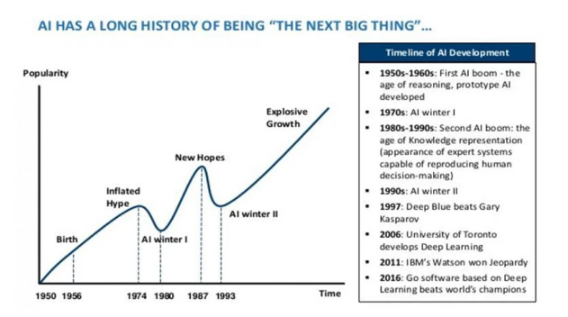
History of A.I.
Discovery

Slide 8
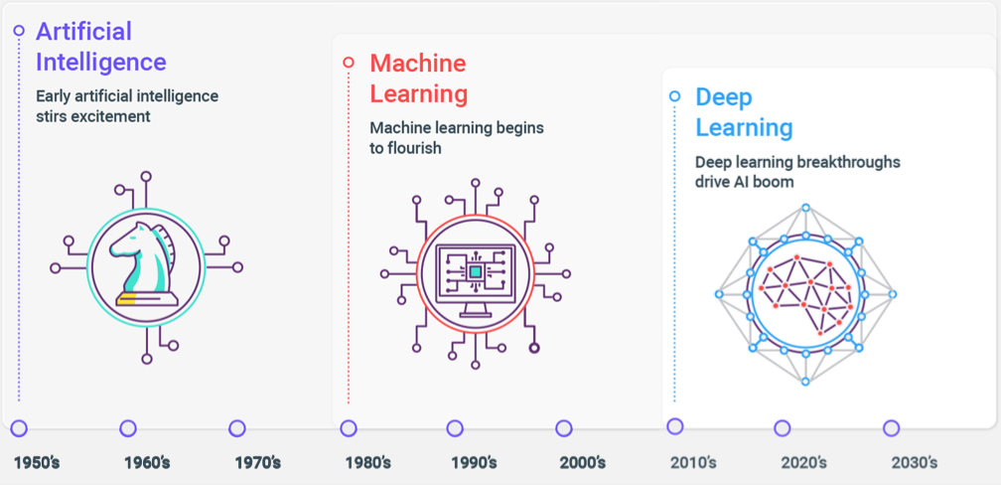

History of A.I.
Discovery

Slide 9
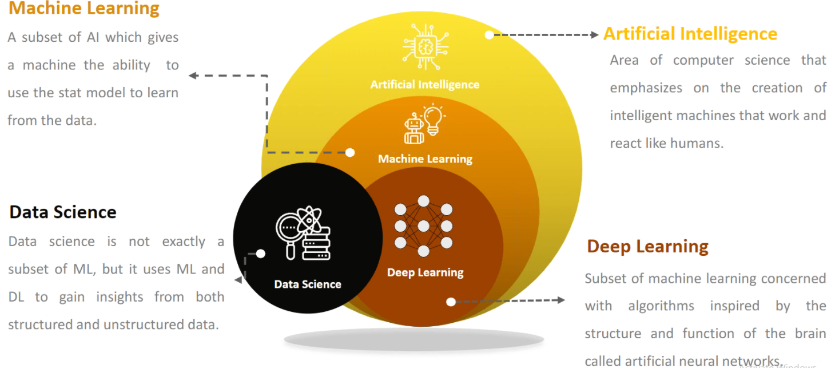
AI > ML > DL versus Data Science
Discovery
Notes:
Don’t forget the data science. We’ll lean heavily on data science in this course.

Slide 10
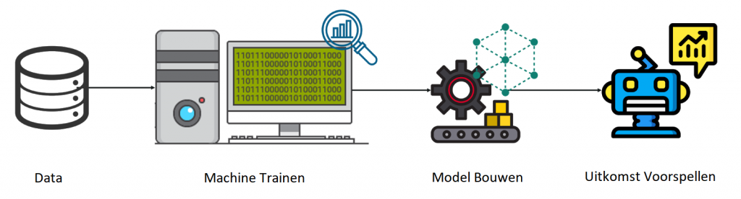
Domain of Machine Learning

Slide 11
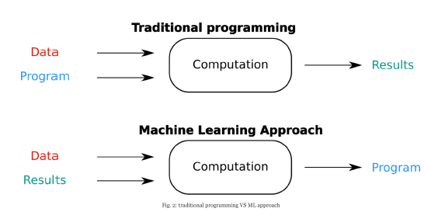
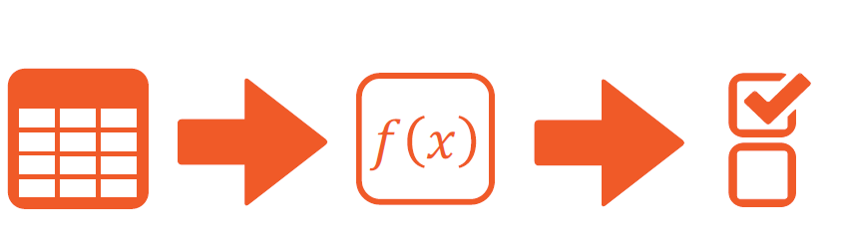
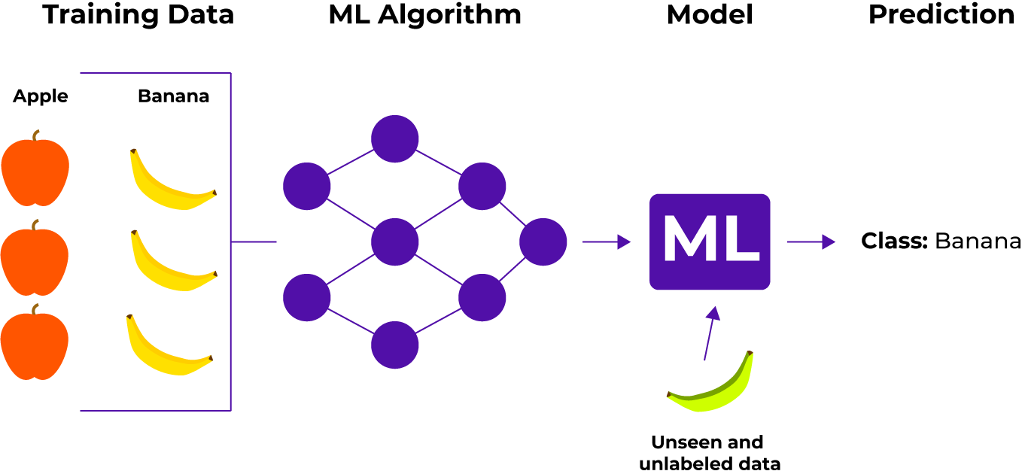
Machine Learning = Data Driven, Learning
Discovery

Slide 12

Machine Learning runs on DATA…
Discovery

Slide 13
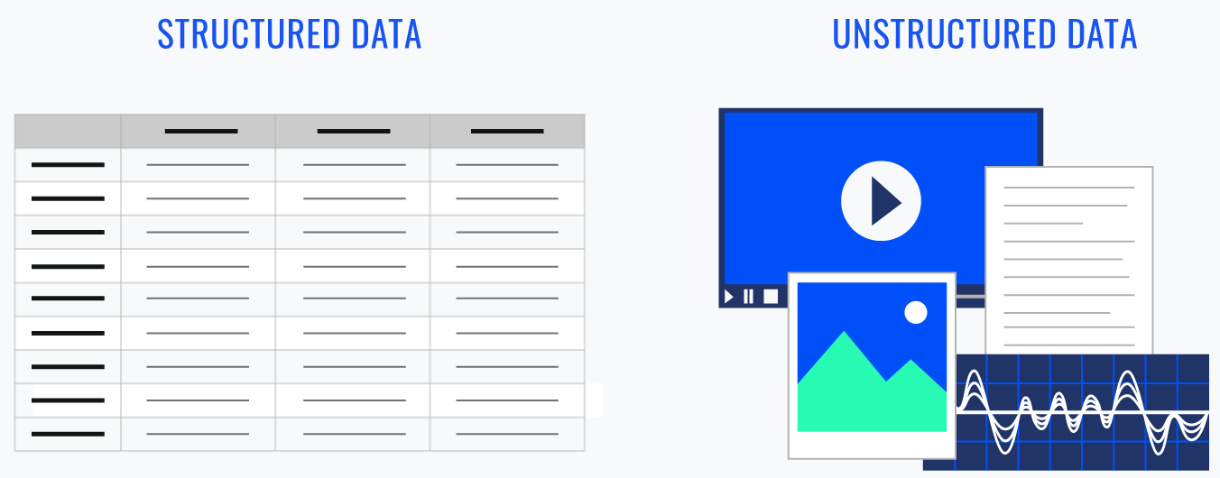
Data, It’s all about the data…
Discovery

Slide 14
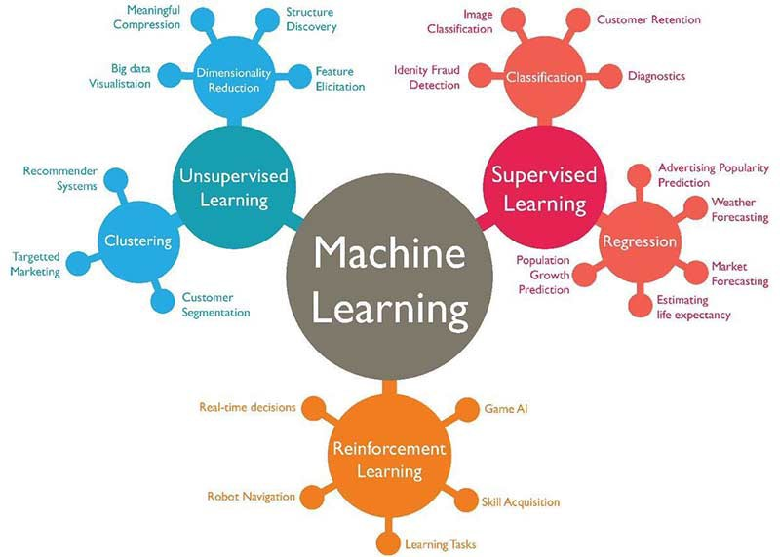
ML: Supervised – Unsupervised – Reinforcement Learning
Discovery

Slide 15
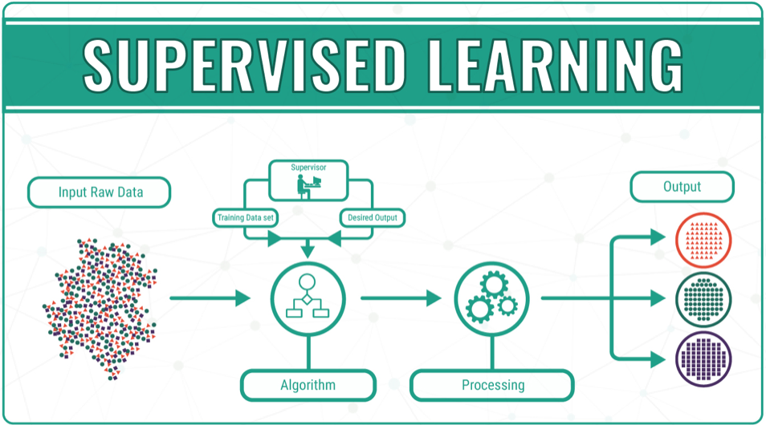
ML Learning: 1. Supervised
Discovery

Slide 16


Classification versus Regression
Discovery

Slide 17
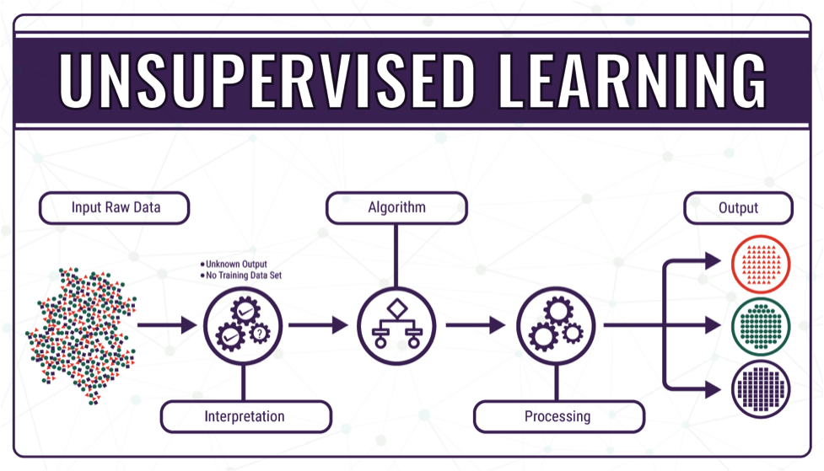
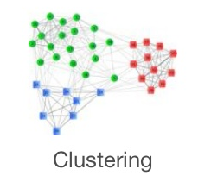
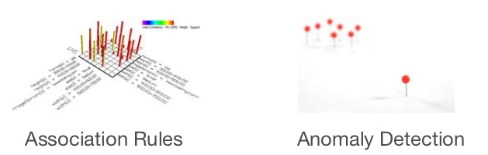
ML Learning: 2. Unsupervised
Discovery

Slide 18
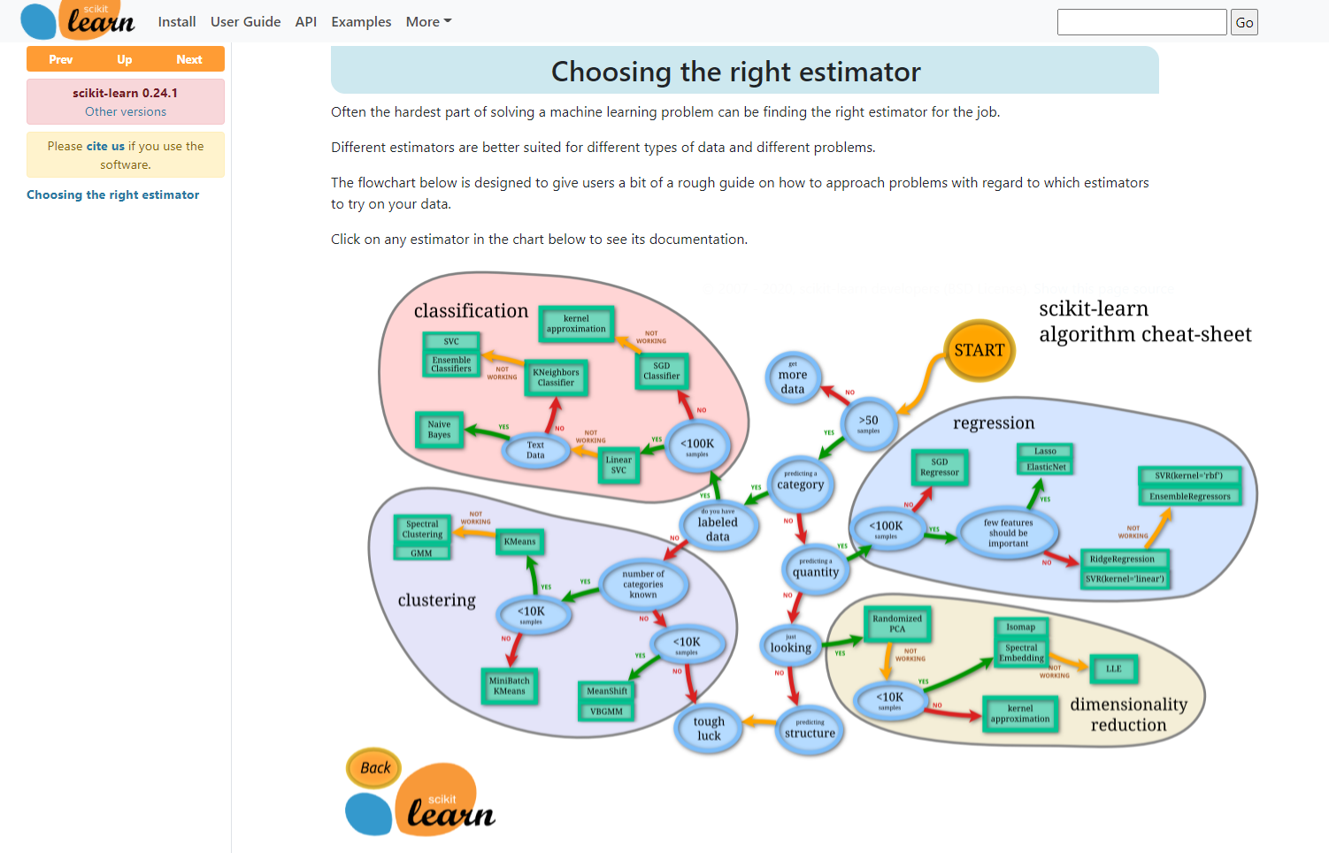
Scikit-Learn: Cheat Sheet
Discovery
Notes:
https://scikit-learn.org/stable/tutorial/machine_learning_map/index.html

Slide 19
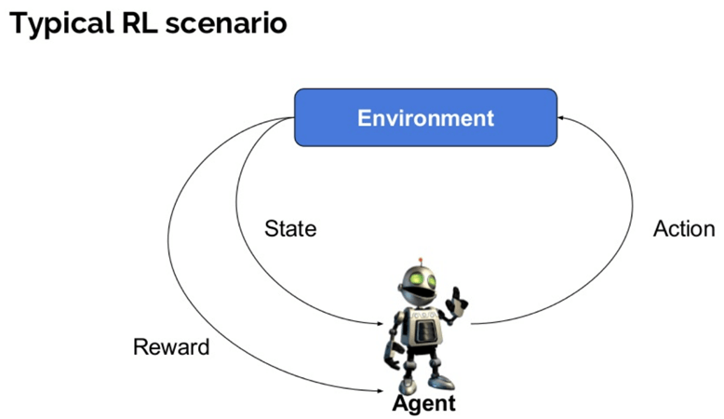
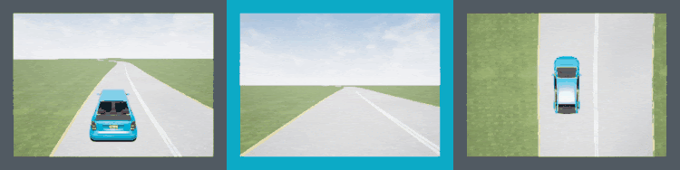
ML Learning: 3. Reinforcement
Discovery

Slide 20
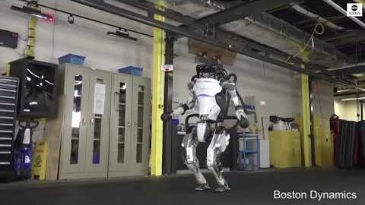
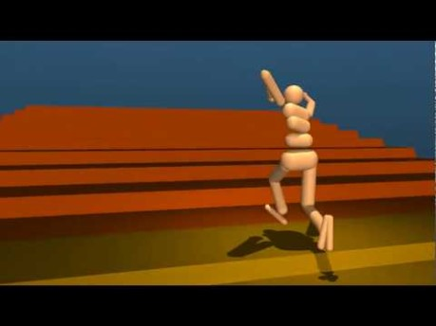
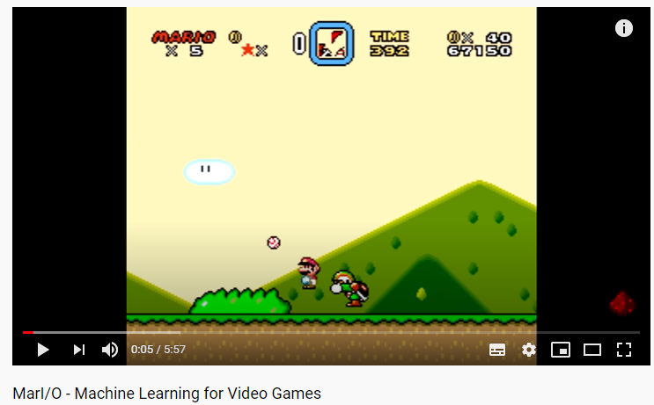
Reinforcement Learning: next big thing?
Discovery
Notes:
Boston Dynamics: https://www.youtube.com/watch?v=_il7PrOUmrA&ab_channel=ABCNews
DeepMind Locomotion: https://www.youtube.com/watch?v=hx_bgoTF7bs&ab_channel=DeepMind
Mari/o: https://www.youtube.com/watch?v=qv6UVOQ0F44&ab_channel=SethBling

Slide 21
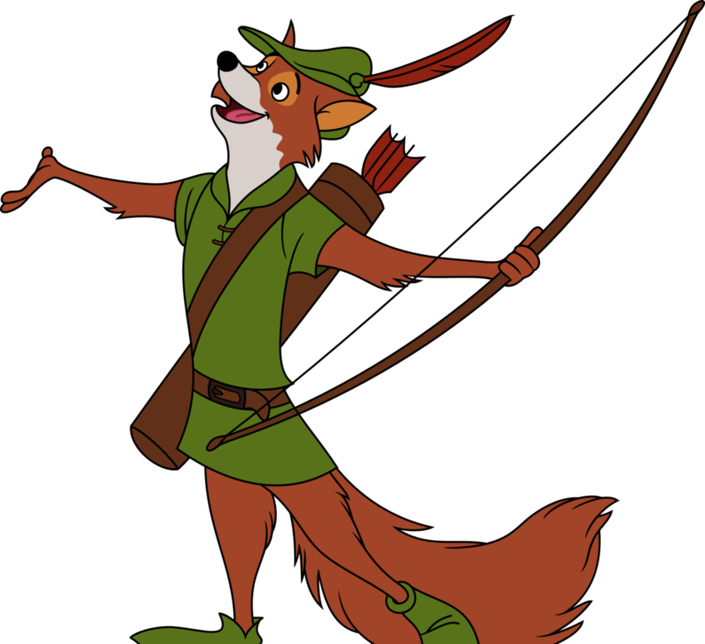
[End of thievery]

Slide 22
Summary
AI has come a long way, and is going a long way
Our focus is machine learning on structured data
‘Basic’ artificial intelligence: AI-course
Unstructured data and neural networks: Big Data course
We’ll be doing supervised learning
We understand and prepare the data
We make actual predictions
We won’t be doing unsupervised learning
We won’t be doing reinforcement learning
Cool, but use cases are limited

Slide 23
Understand the data: data science
This course directly follows data science in 2itf
You’ll need all the skills you picked up there:
Grabbing data
Importing data
Creating graphs
Getting information on data
All using Python and Pandas

Slide 24
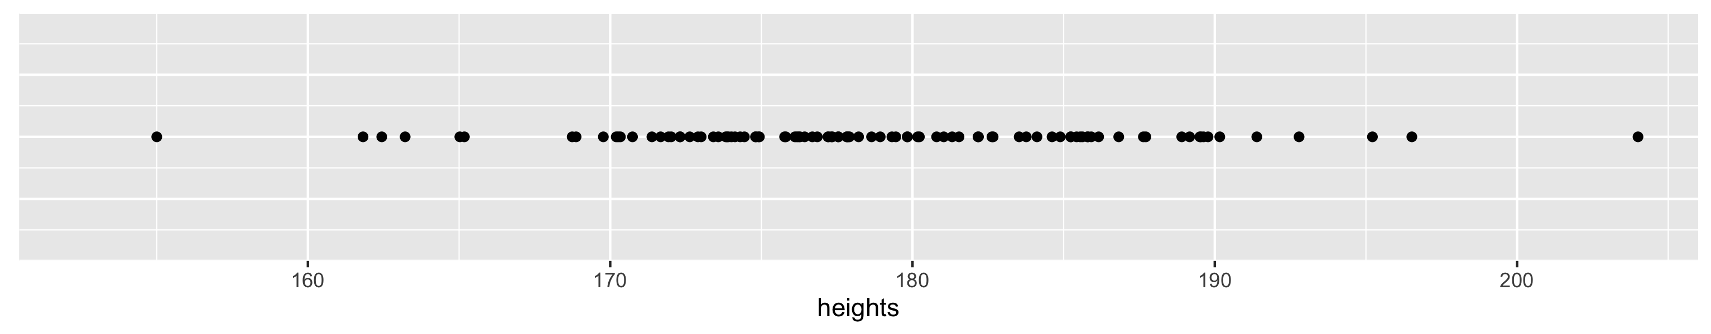
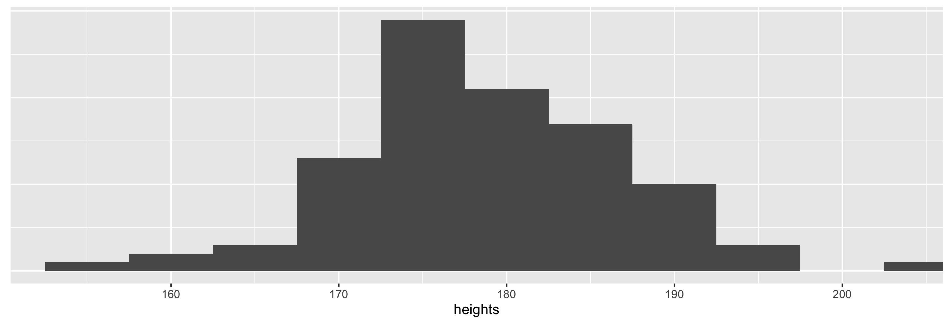
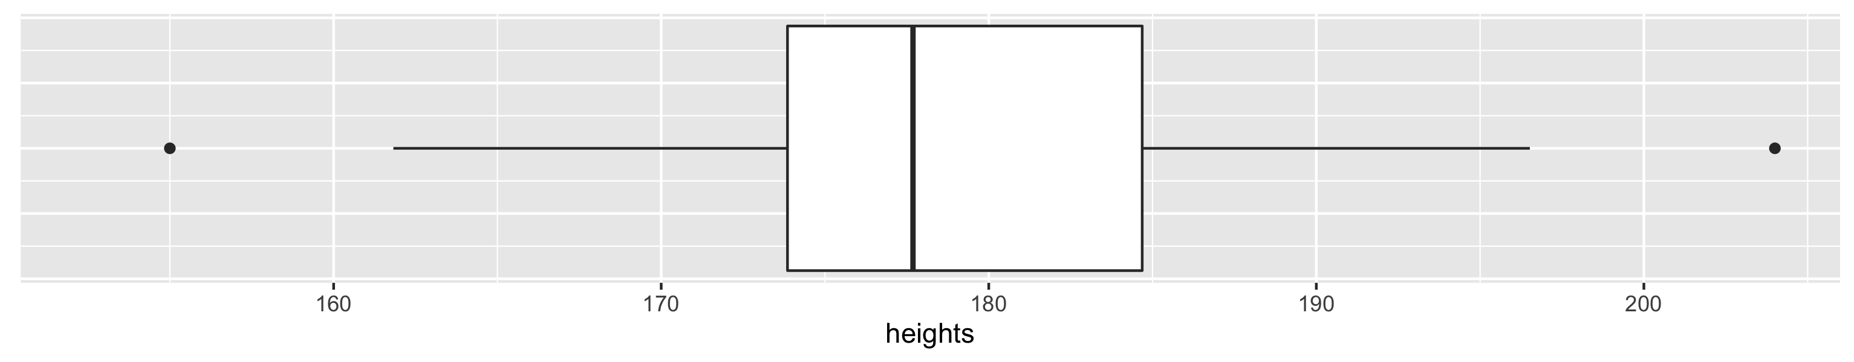
Recap: Histogram and boxplot
IQR Inter-Quartile Range
min
smallest non-outlier
p₂₅
p₅₀
p₇₅
biggest non-outlier
max
boxplot does not show the mean!
1.5 * IQR
IQR
1.5 * IQR
OUTLIERS x < p₂₅ – 1.5 * IQR
OUTLIERS
x > p₇₅ + 1.5 * IQR

Slide 25
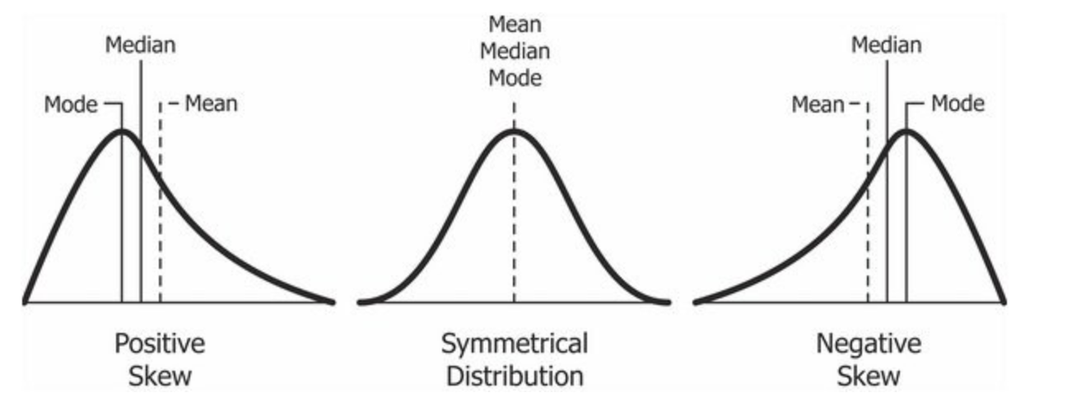
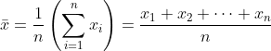
Recap: Mean and median
mean = average
median = “middle number”
mode = “most common value”

Slide 26
Recap: Exploratory data analysis
Variation
How much do values of a same variable change across observations.
“1-D spread” – single spread
Covariation
How much do values of different variables change in a related way.
“2-D spread” – related spread

Slide 27
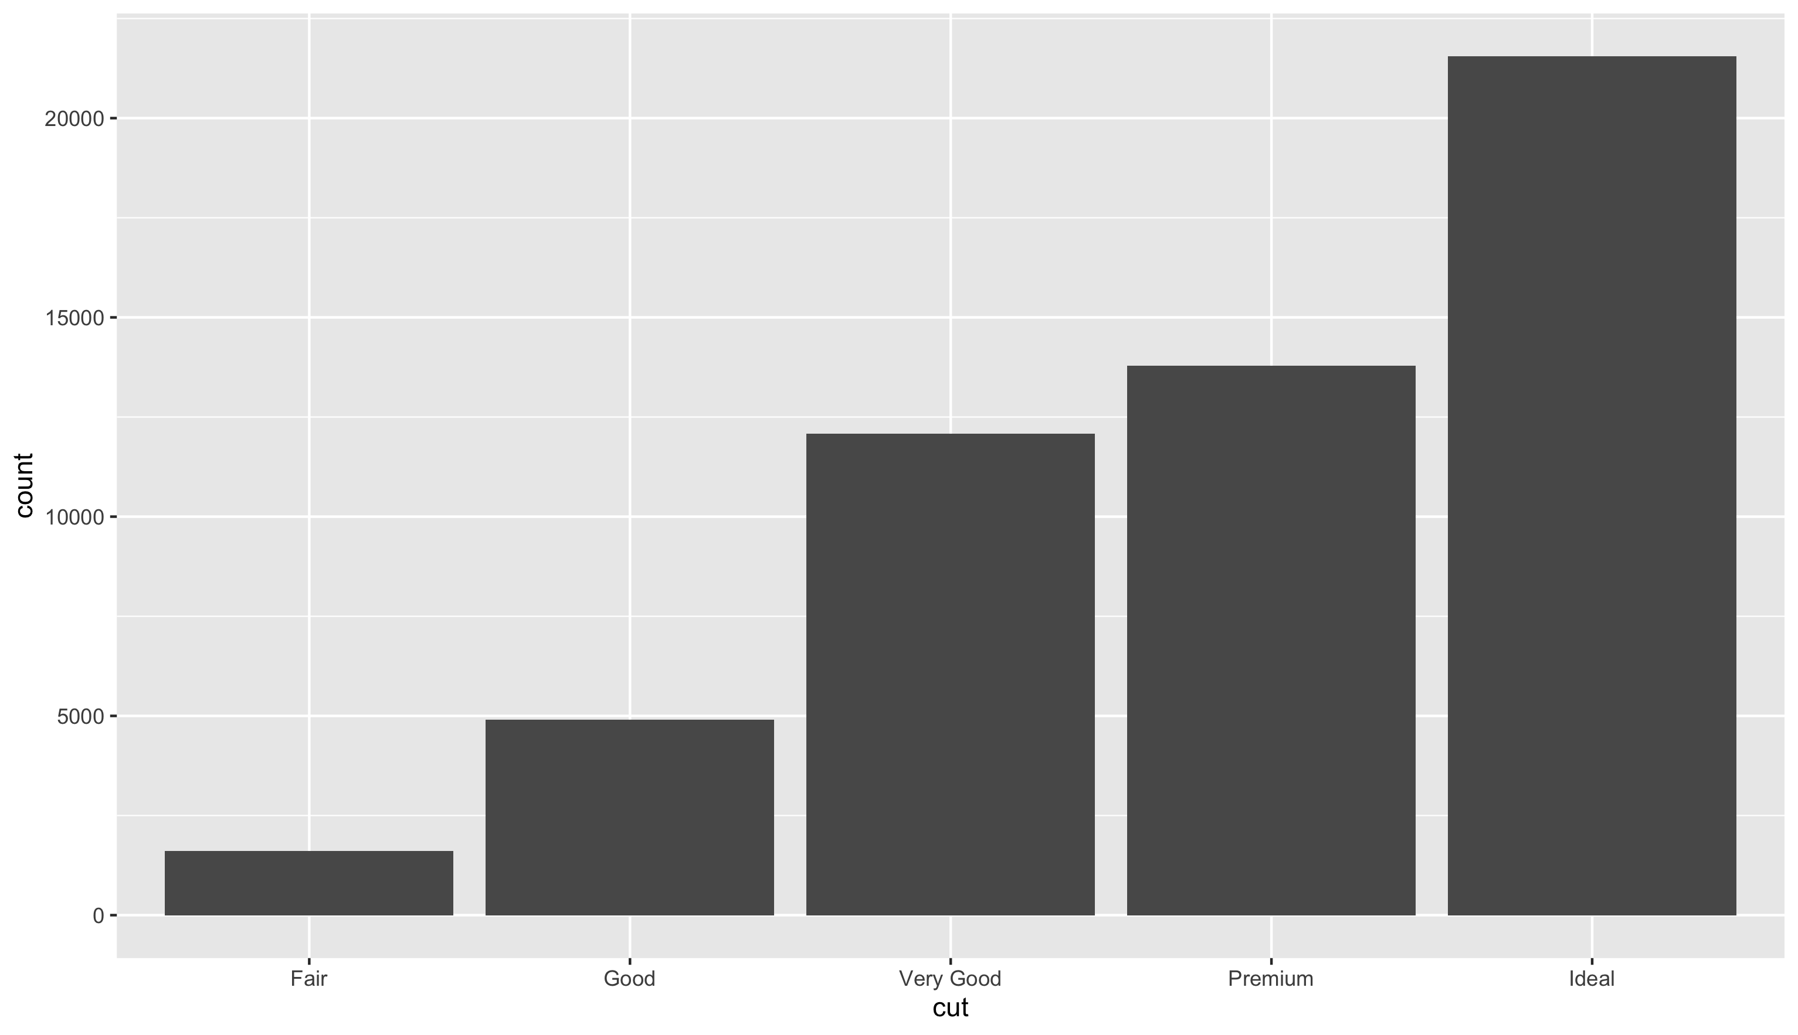
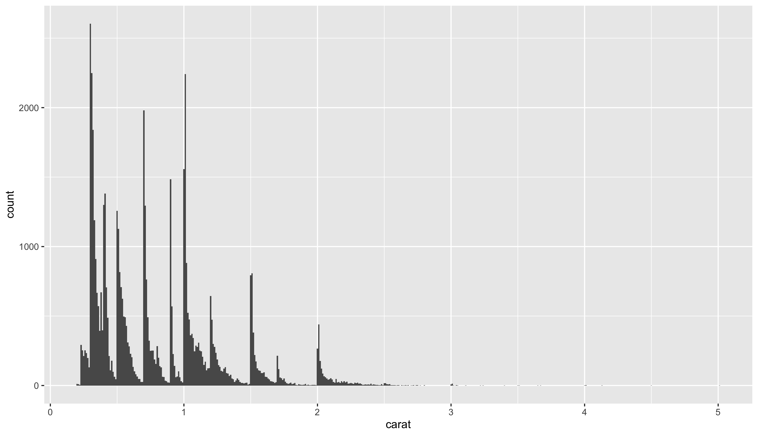
Recap: Exploring variation
Continuous variable
Categorical variable
Bar plot
Histogram

Slide 28
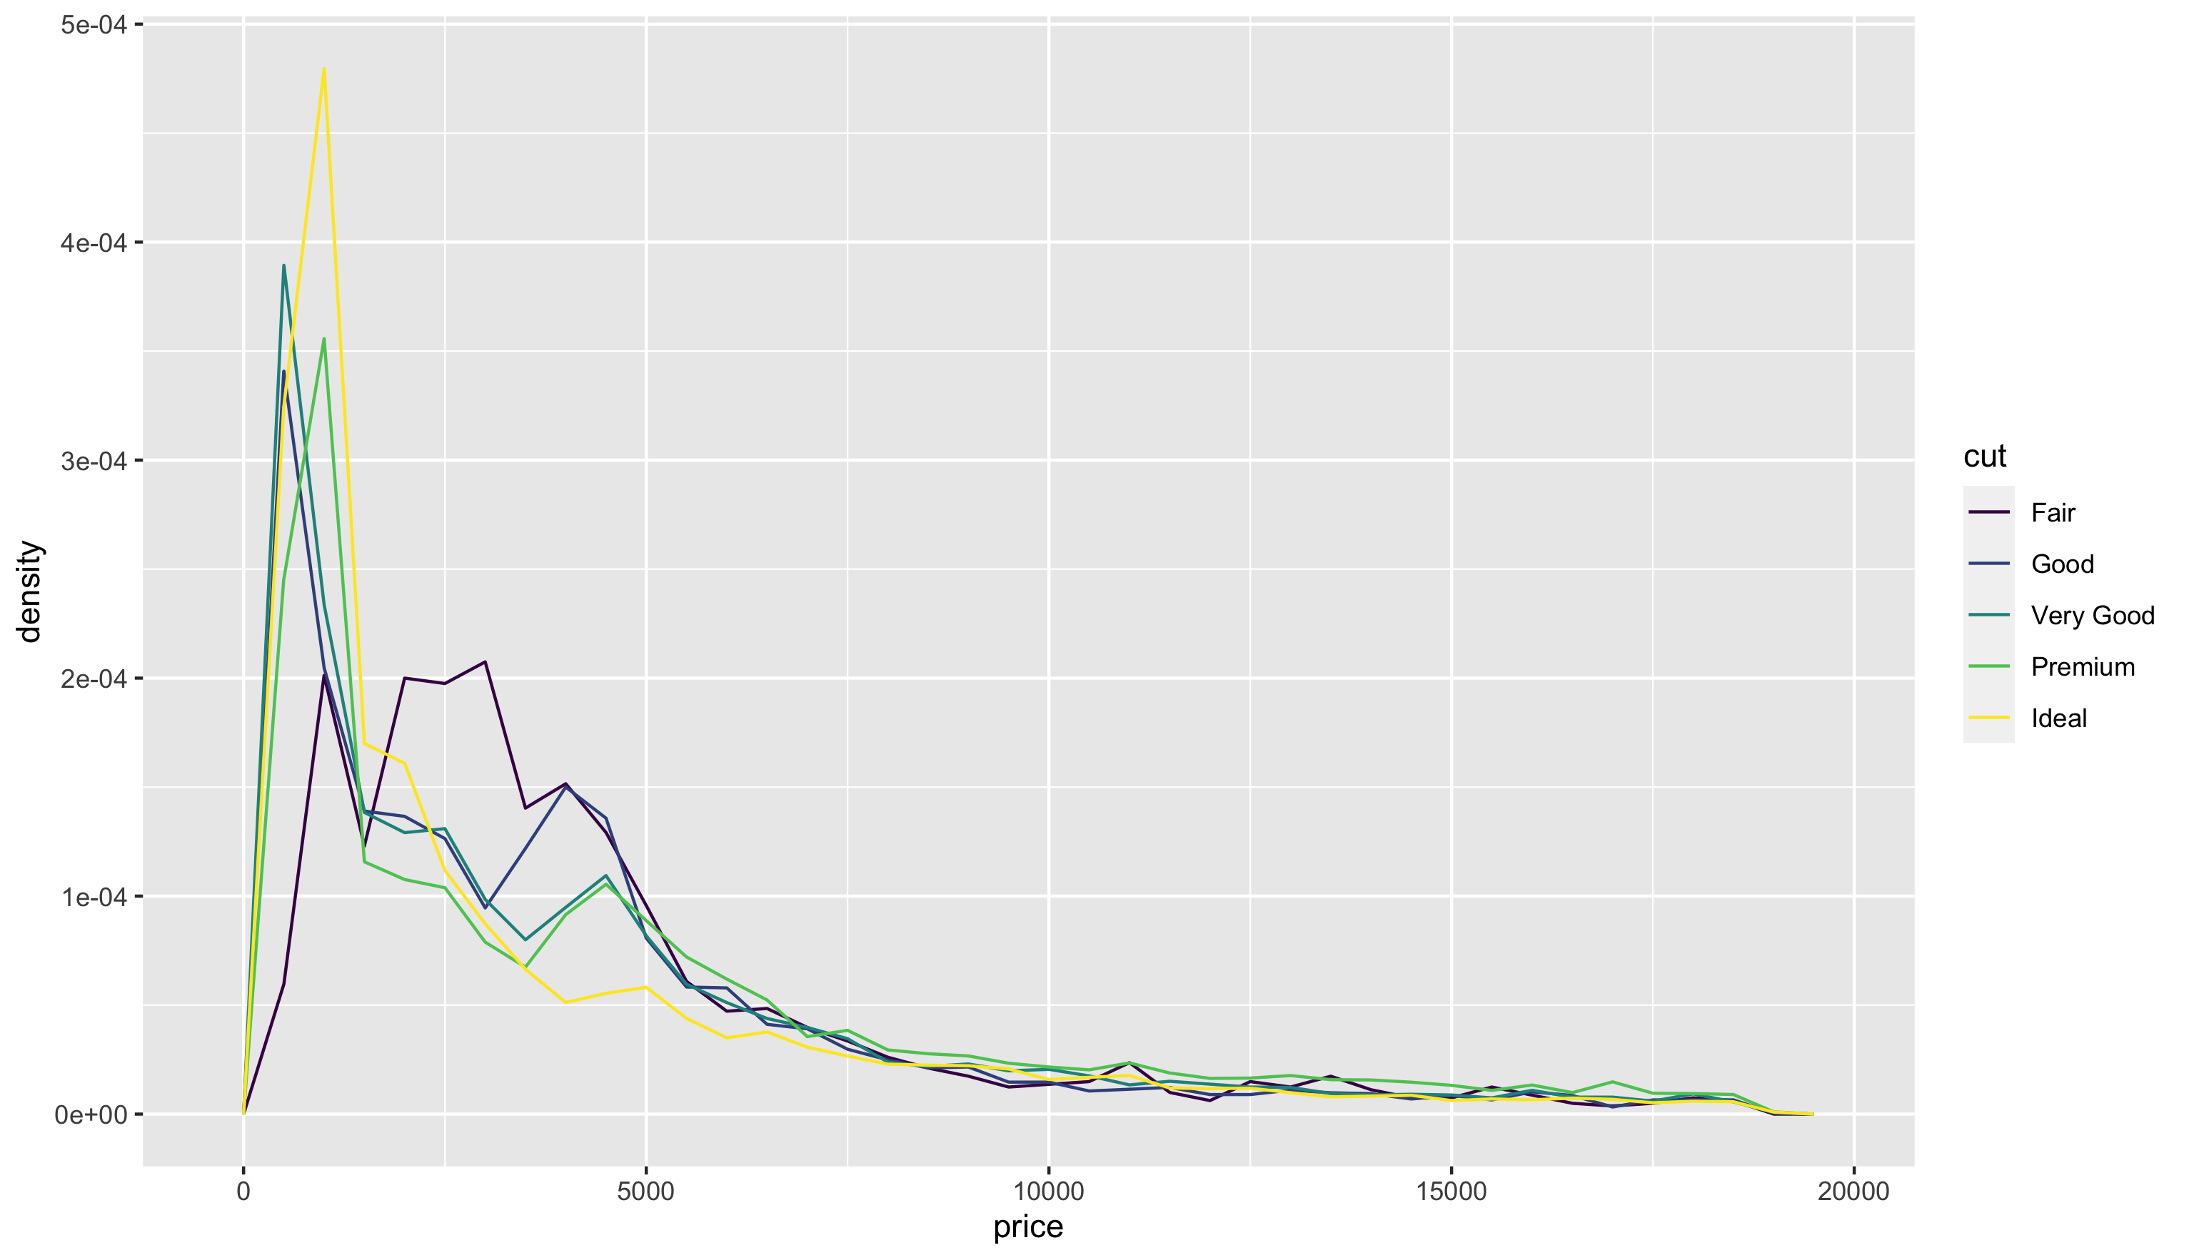
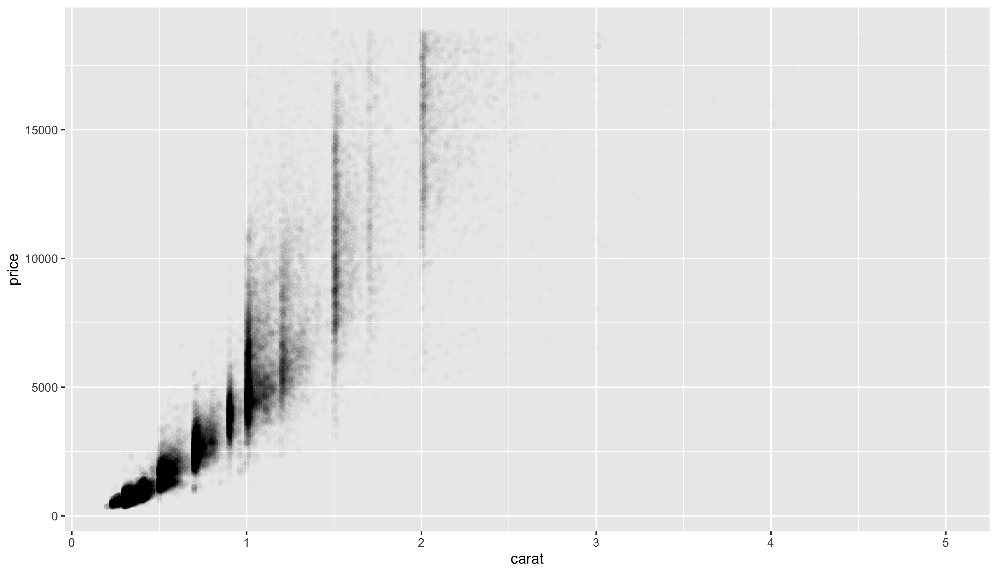
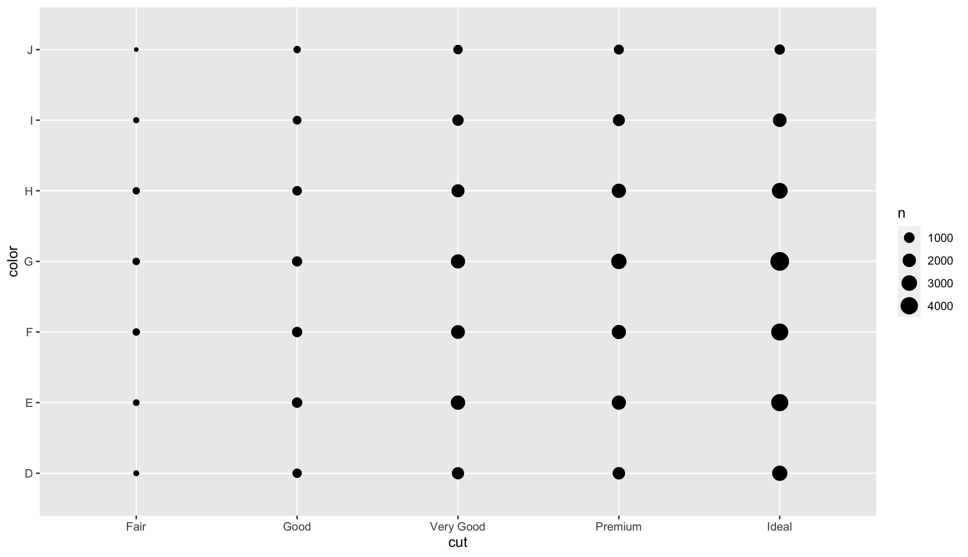
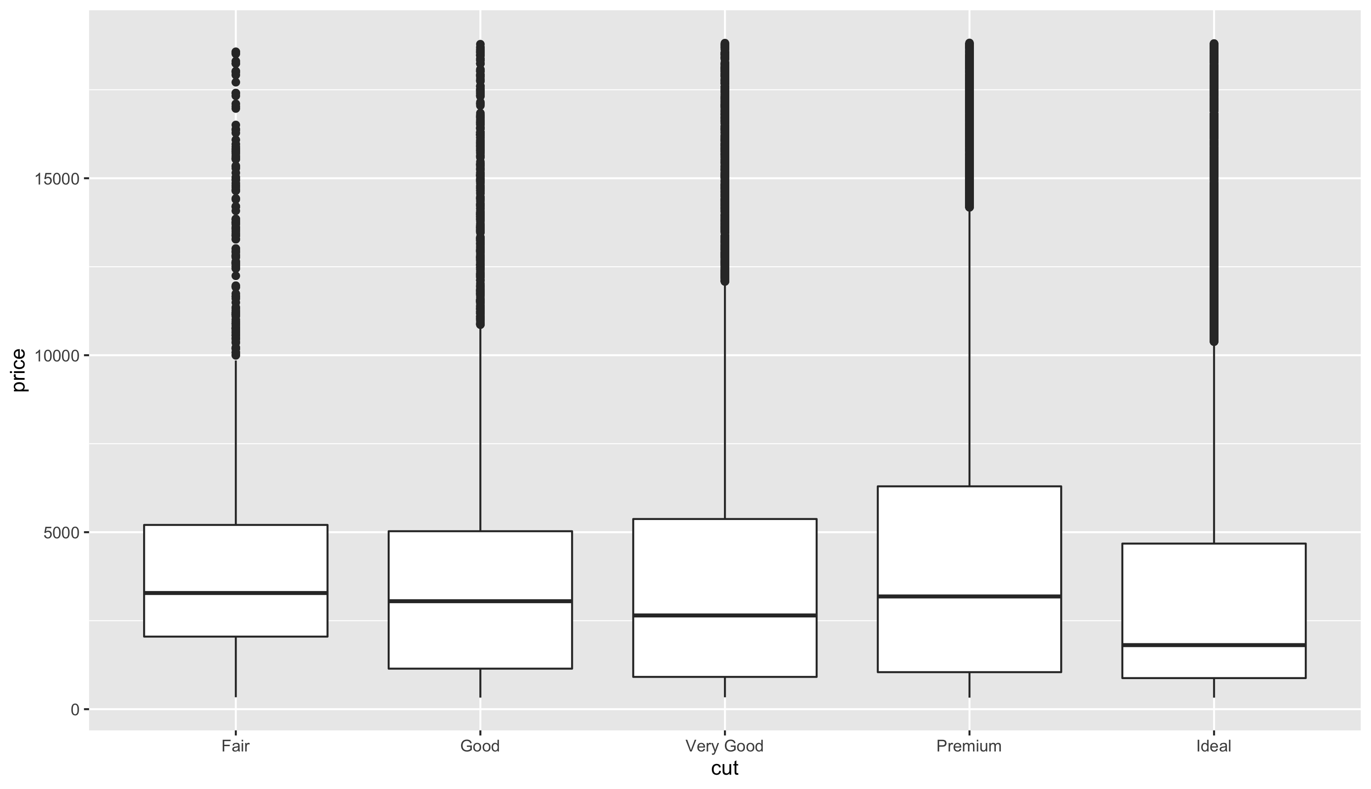
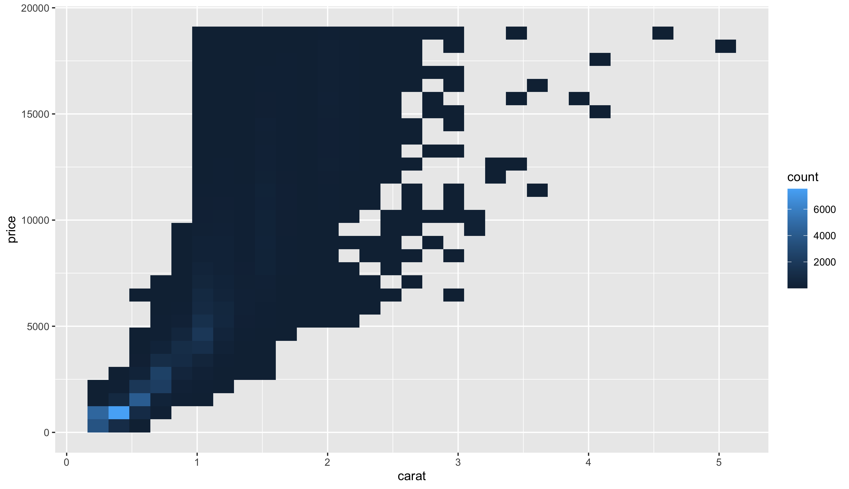
Recap: Exploring covariation
Categorical/Categorical
Continuous/Continuous
Categorical/Continuous
Frequency polygon Grouped boxplot
Two-dimensional grid
Scatter plot 2D histogram

Slide 29
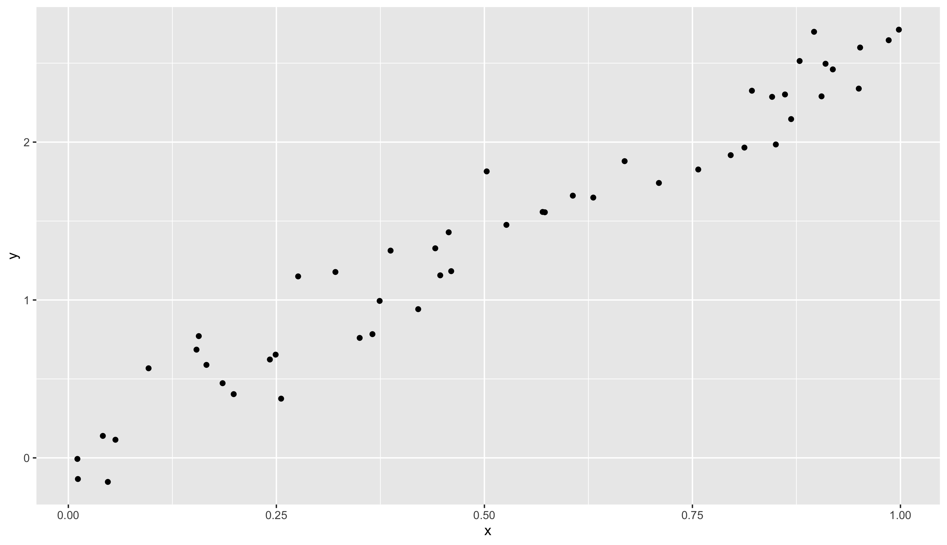
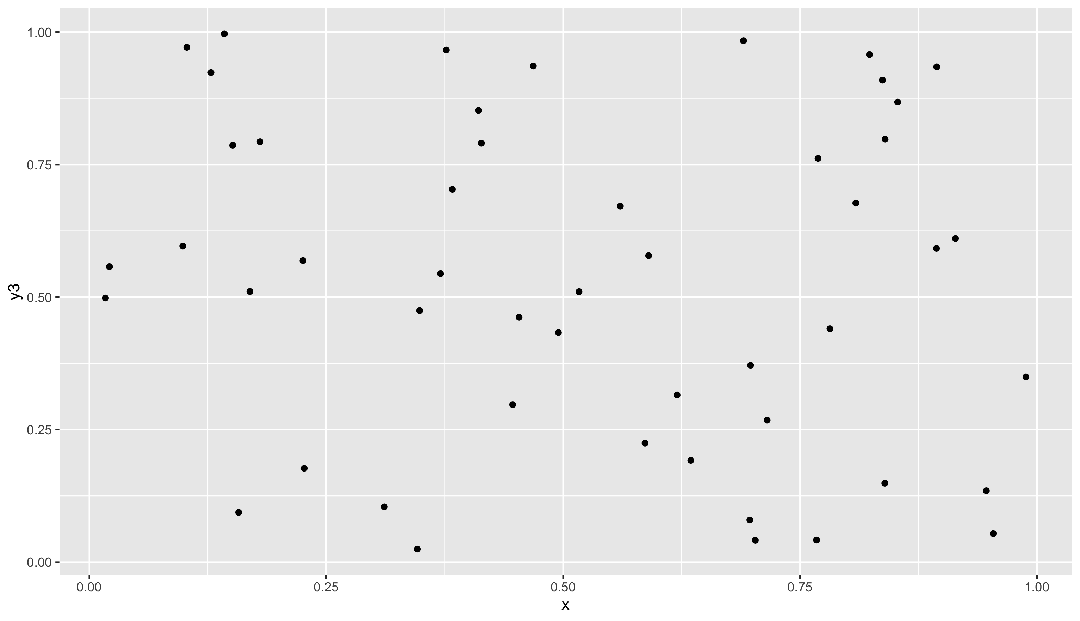
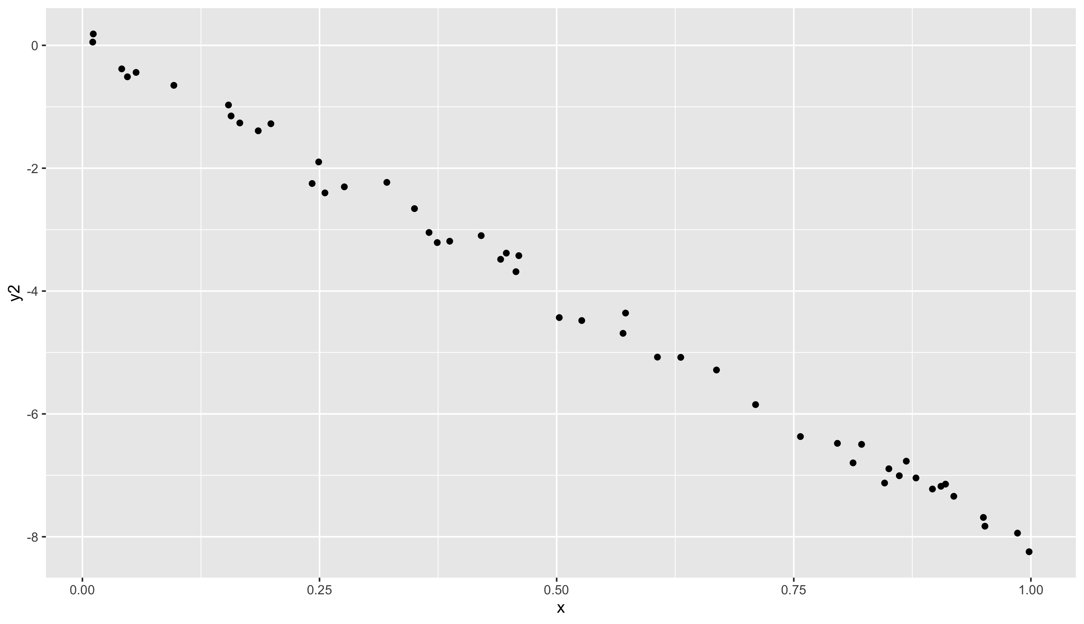
Recap: Covariance and correlation
Correlation ≈ 1 Strong positive relationship
Correlation ≈ 0
No relationship
Correlation ≈ -1
Strong negative relationship

Slide 30
Storytelling
Check out Hans Rosling:
Let my dataset change your mindset - link
The best stats you’ve ever seen – link
How not to be ignorant about the world - link

Slide 31
Recap: Virtual Environments
Every project you do goes in its own personal virtual environment
Never in the main environment unless it uses no libraries
Git is useful but optional, virtual environments are not
(optional, as it is very useful)
You can do all notebooks for this class in one virtual environment
Code to create one in the comments below

